Slide 1
Fair Tests

Slide 2

After this Smart lesson you will be able to:
Determine what constitutes a fair test.
Discuss how to conduct a fair test.

Slide 3

A variable is something that can be measured, changed or controlled.
Height, mass, velocity, distance and many other things can be variables.
For example, you might measure the speed of two racing cars to show that one racing car goes faster than the other. The speed is a variable.

Slide 4
There are some variables that we need to control.
When we are planning the investigation, there might be many other variables that could affect the speed, such as the wind, the weight of the car, if the track is wet and many more.
If these variables were not controlled, the results of the investigation will be affected.

Slide 5
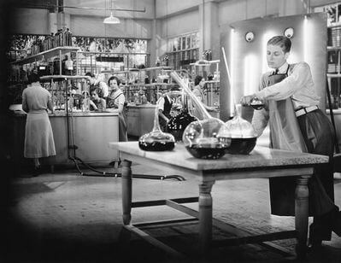
A fair test is an investigation where only one variable is changed, one variable is measured as it changes and the other condition is kept the same.
When we are planning a scientific investigation, we need to think about how we can control some of the variables that we aren't interested in.
This is how we know that only the variable we change will affect the variable we want to measure.

Slide 6

A fair test will change one variable and measure the change in another.
All of the other variables are controlled, or kept constant, so that they do not affect what you are measuring.

Slide 7

The variables we don't want to measure might interfere with results of the variables we do want to measure and so the test would not be fair.

Slide 8
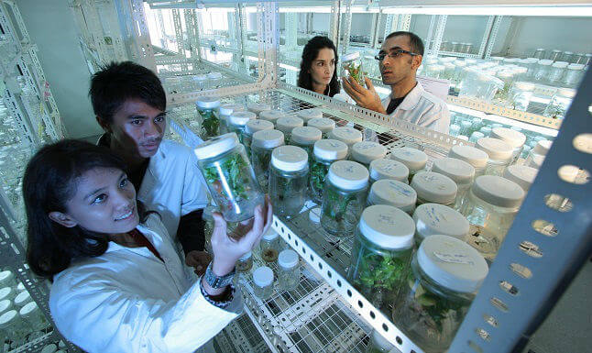
If a variable that we do not want to test or measure is affecting our results, we need to control it so it stays constant throughout our experiment.
A variable that is controlled and kept constant is called a control variable.

Slide 9

If we are changing more than one thing in our experiment, then other variables can affect our data and make our test less fair.
Therefore, we need to identify the variables and choose appropriate ways to control them.

Slide 10

For Example:
Sally wanted to test whether fertiliser A or fertiliser B causes her plants to grow better.
She used eight of the same type of plant and put fertiliser A on four of the plants and fertiliser B on the other four plants.
She put the plants with fertiliser A on the windowsill in the classroom, but then ran out of space and so had to put the plants with fertiliser B in the corridor.
Do you think this is a fair test?

Slide 11
We re-design the experiment to control the variable and make sure we are only changing one thing at a time.
To make a fair test, Sally could find another space to put the plants so they all get the same amount of sunlight.

